Slide 1

SHREE SWAMI ATMANAD SARASWATI INSTITUTE OF TECHNOLOGY
DIGITAL PLATFORM FOR BOOK SHARING
PREPARED BY: Ajudiya Dharati

Slide 2
PROBLEM STATEMENT:
DIGITAL PLATFORM FOR BOOK SHARING…..

Slide 3
ABSTRACT
Sharing books is the most basic form of sharing knowledge. But, sharing books manually may be tedious and not always convenient. The project aims at providing a digital medium to share books and provide readers a platform for discussing books. It majorly delves into the system of customer to customer business model to create a conducive and beneficial environment for both the user and providers. The system provides a platform for institute students to share their old books or stationery and also take books from other alumni of institute. On the system on chatting feature is provided on that communication gap can overcome and discuss about future scope and also discuss subject related queries.

Slide 4
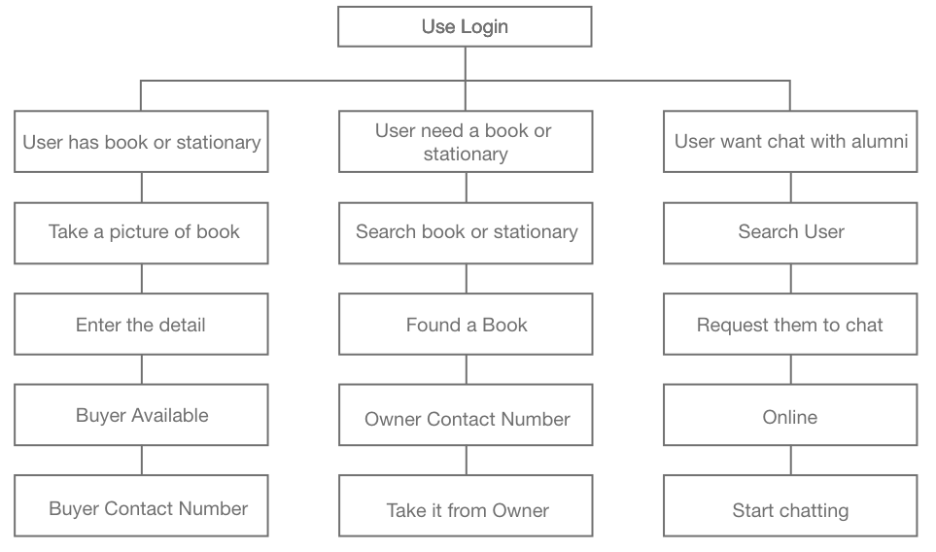
FLOW CHART

Slide 5
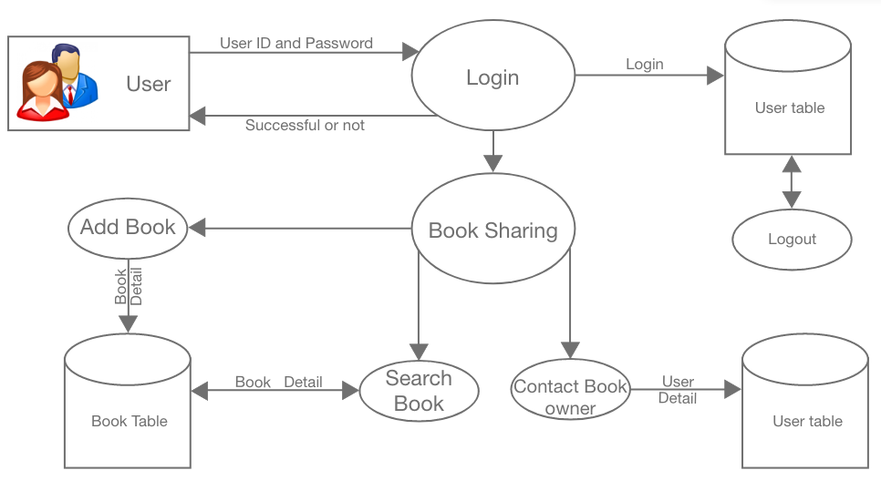

Slide 6
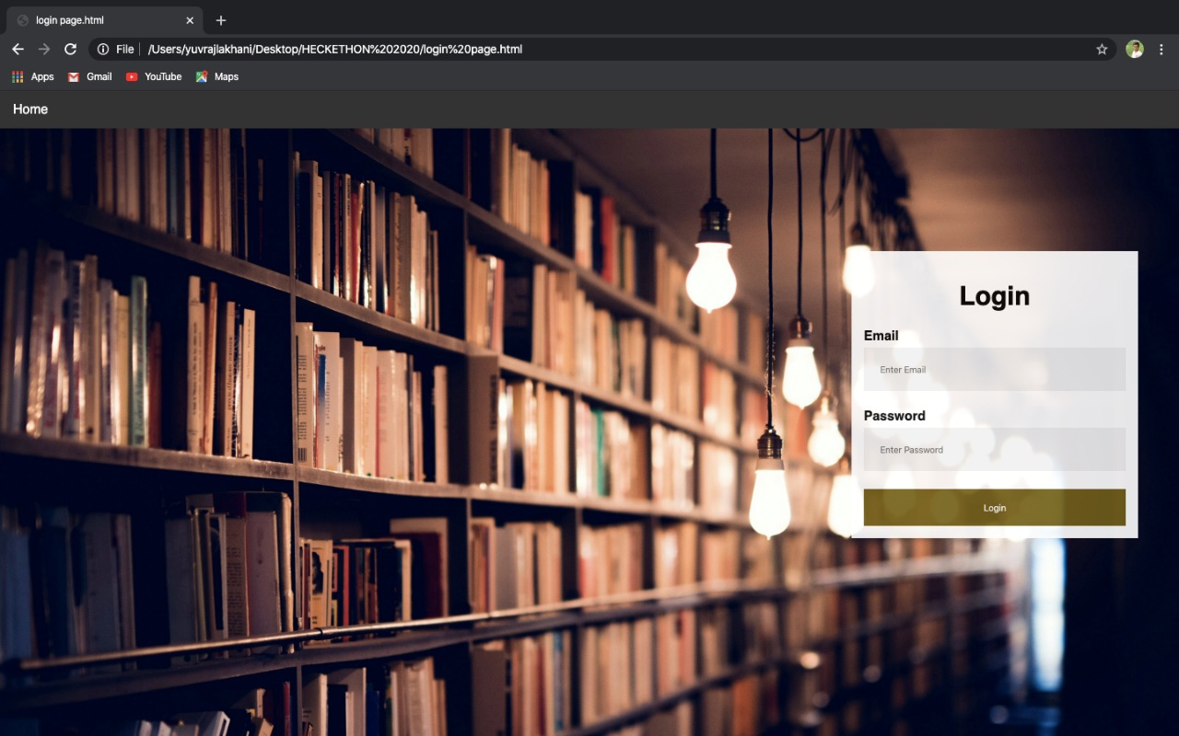
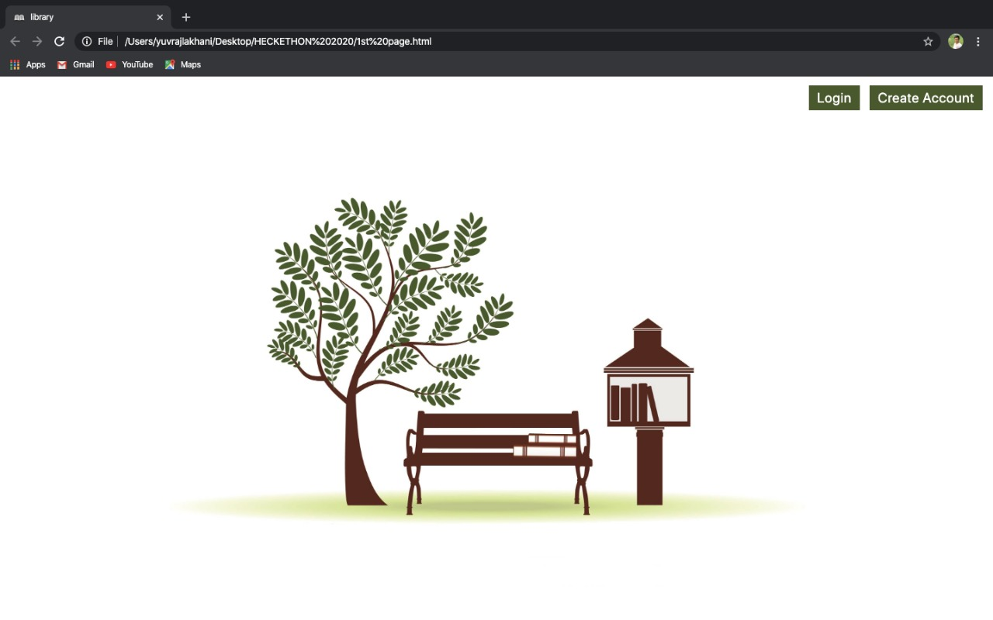
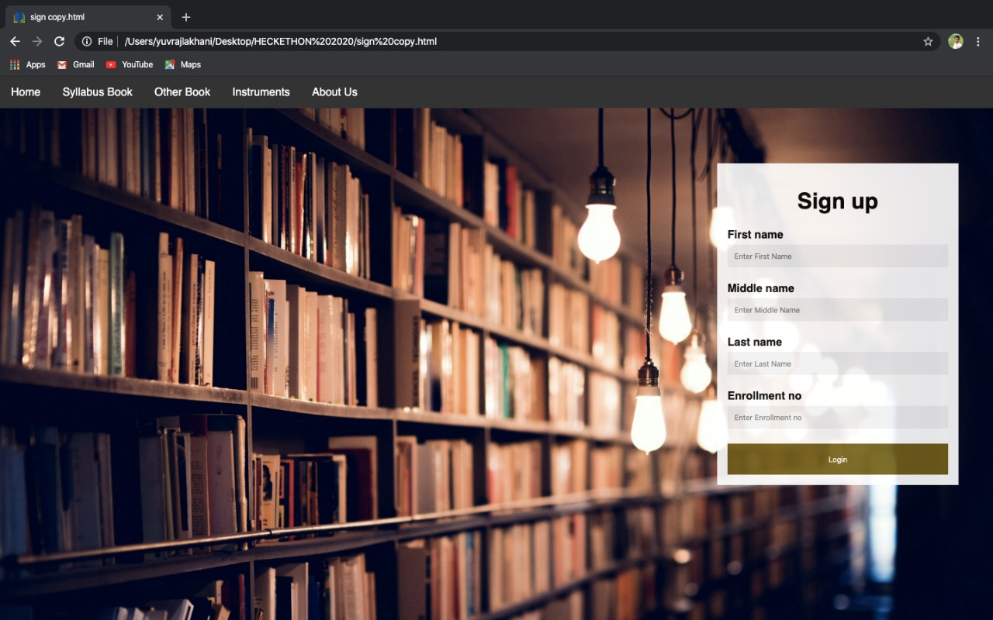
LOGIN PAGE HOME PAGE REGISTRATION PAGE
PROTOTYPE

Slide 7
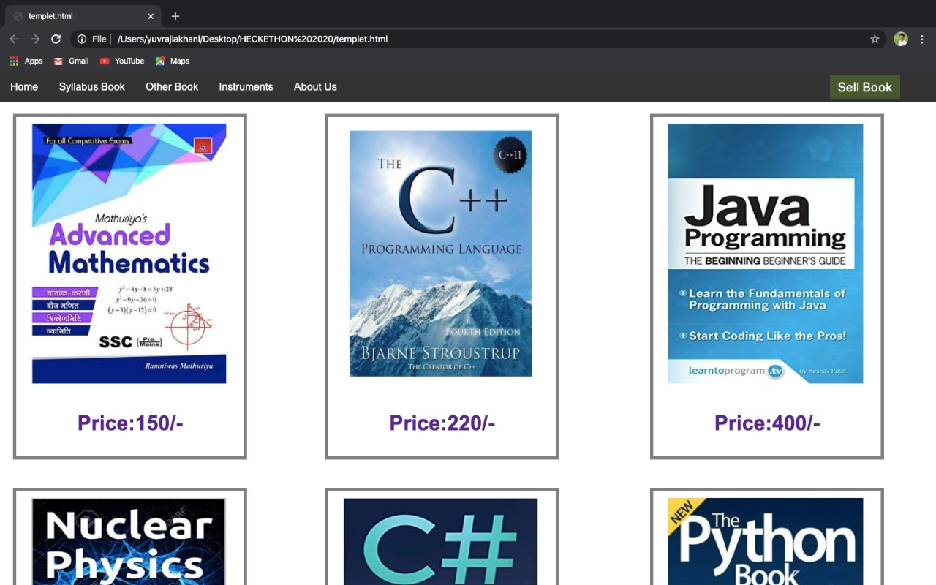
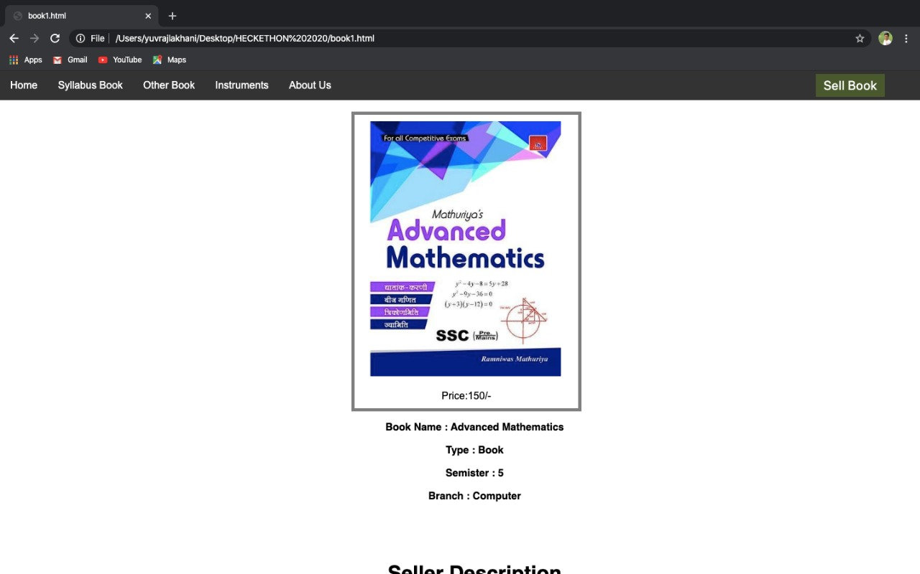
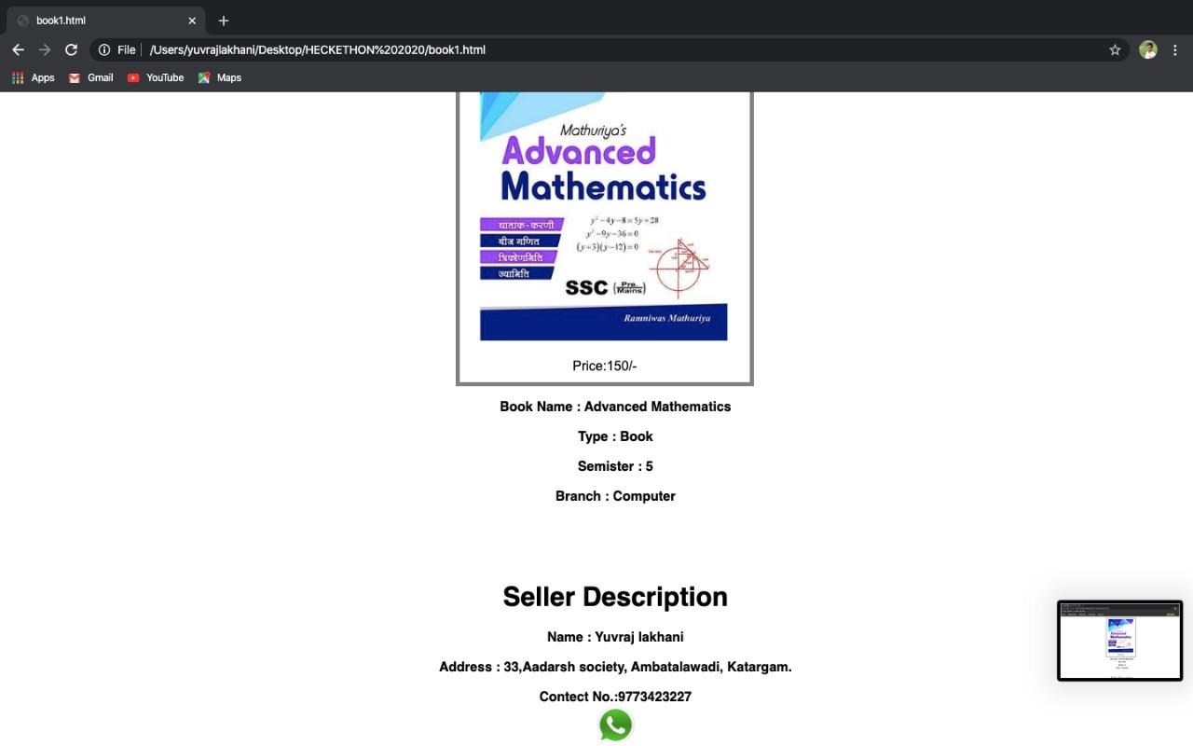
STUDY BOOKS BOOK DESCRIPTION SELLER DESCRIPTION
PROTOTYPE

